Slide 1
  You can use the sample slide 3 to make your own and then download just that page as a png. Then you can upload the image to Blackboard as your banner.
  We have text for reference in slide 3, but when possible, we recommend sticking with decorative images. Text in images often has poor usability or accessibility. Abstract images or an image with a focus at the center work better for a banner, due to cropping variability.
  The visible width ranges from 550 to 1200 pixels. The visible height ranges from 150 to 240 pixels. Thus, you should keep the main content within the center, at 550 x 150 pixels of a 1200 x 240 pixels banner, to guarantee its visibility. Anything outside that 550 x 150 central pixel area may be cropped out in some views.
  While we can’t accommodate complex graphic design requests, we can help with basic customization to fit these size guidelines. Please allow at least two weeks’ for us to complete the request. Email uas.celt@alaska.edu with requests.

Slide 2

The total size of your banner needs to be at least 1200x240, but the “safe zone” is a smaller rectangle in the center
This is a 550x150 “safe zone.” Put important content here.
Anything outside the “safe zone” will appear on larger screens but may be cut off on smaller screens; choose your image(s) accordingly

Slide 3
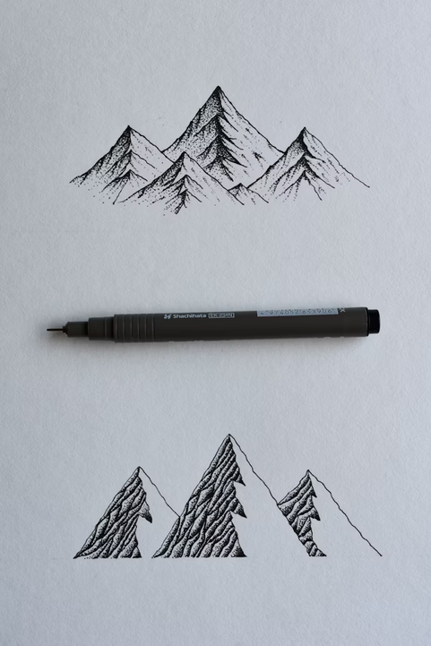

Your content here

